Slide 1
EMERY GROVER BUILDING
Renovation for the
Needham Public Schools Administration
Presentation to the
Annual Town Meeting
May 2, 4, 9 & 11, 2022
Warrant Article #21
Town of Needham PPBC
Needham Public Schools Administration
Bargmann Hendrie + Archetype, Inc.

Slide 2
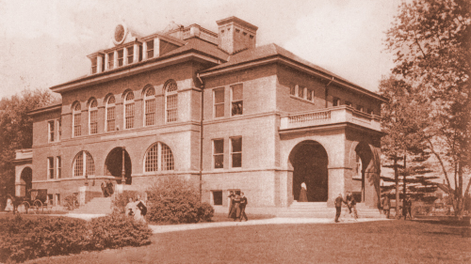
The Emery Grover Building
was constructed in 1898
It was listed on the
National Register of Historic Places in 1987
Originally constructed as a High School, then used as a Middle School and Elementary School
it has been the home for
School Administration since 1947

Slide 3
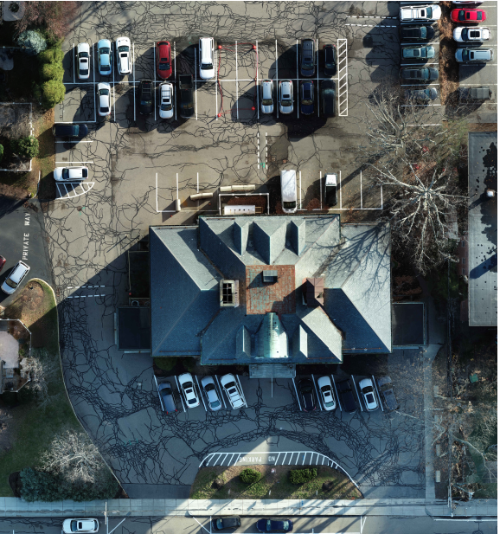
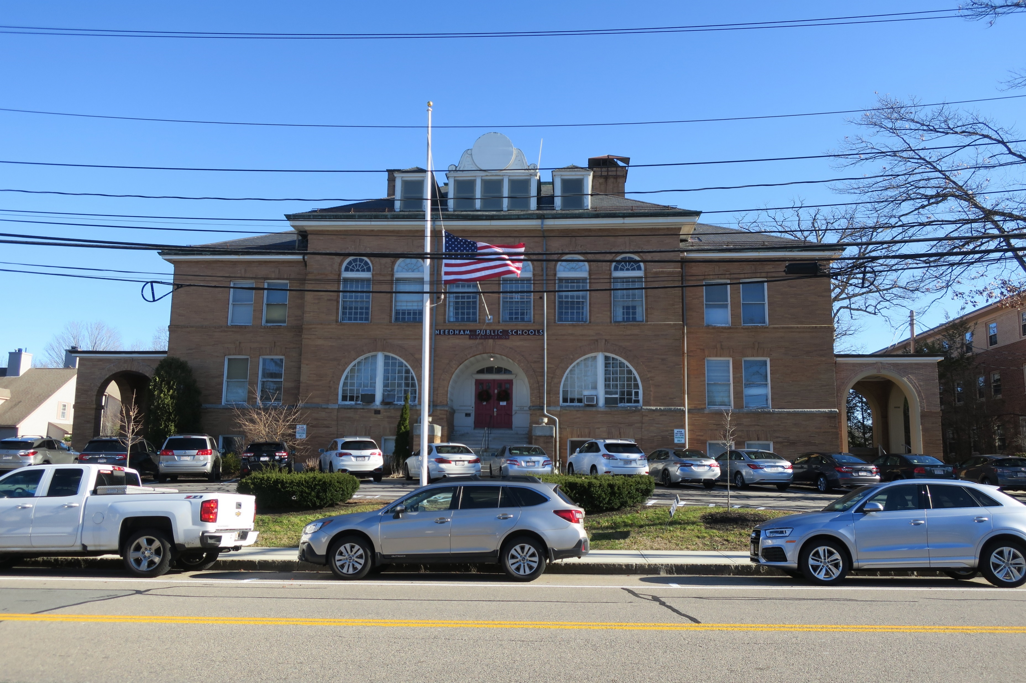
PROPOSED
SITE PLAN
Parking lot removed on Highland Ave

Slide 4
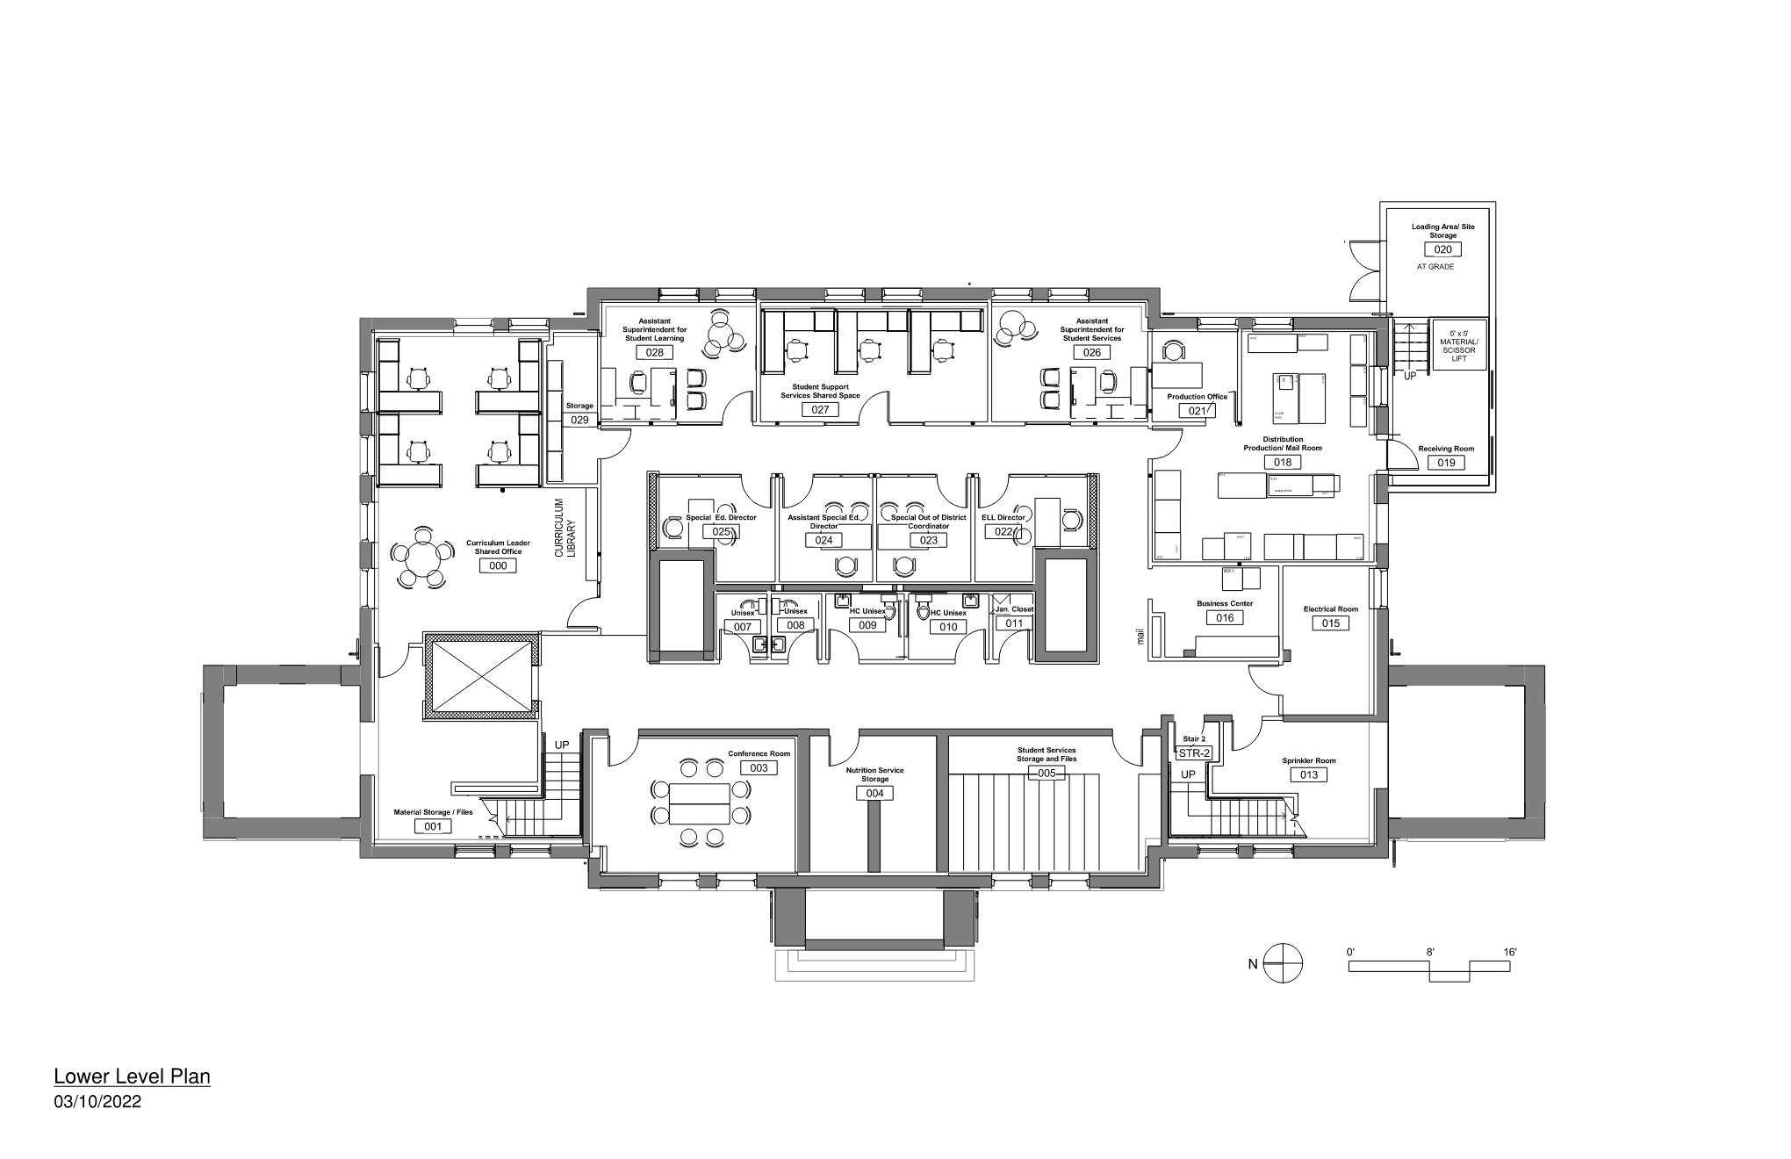
LOWER LEVEL
Student Services
New
Loading
Dock
Student
Learning
Distribution
Center

Slide 5
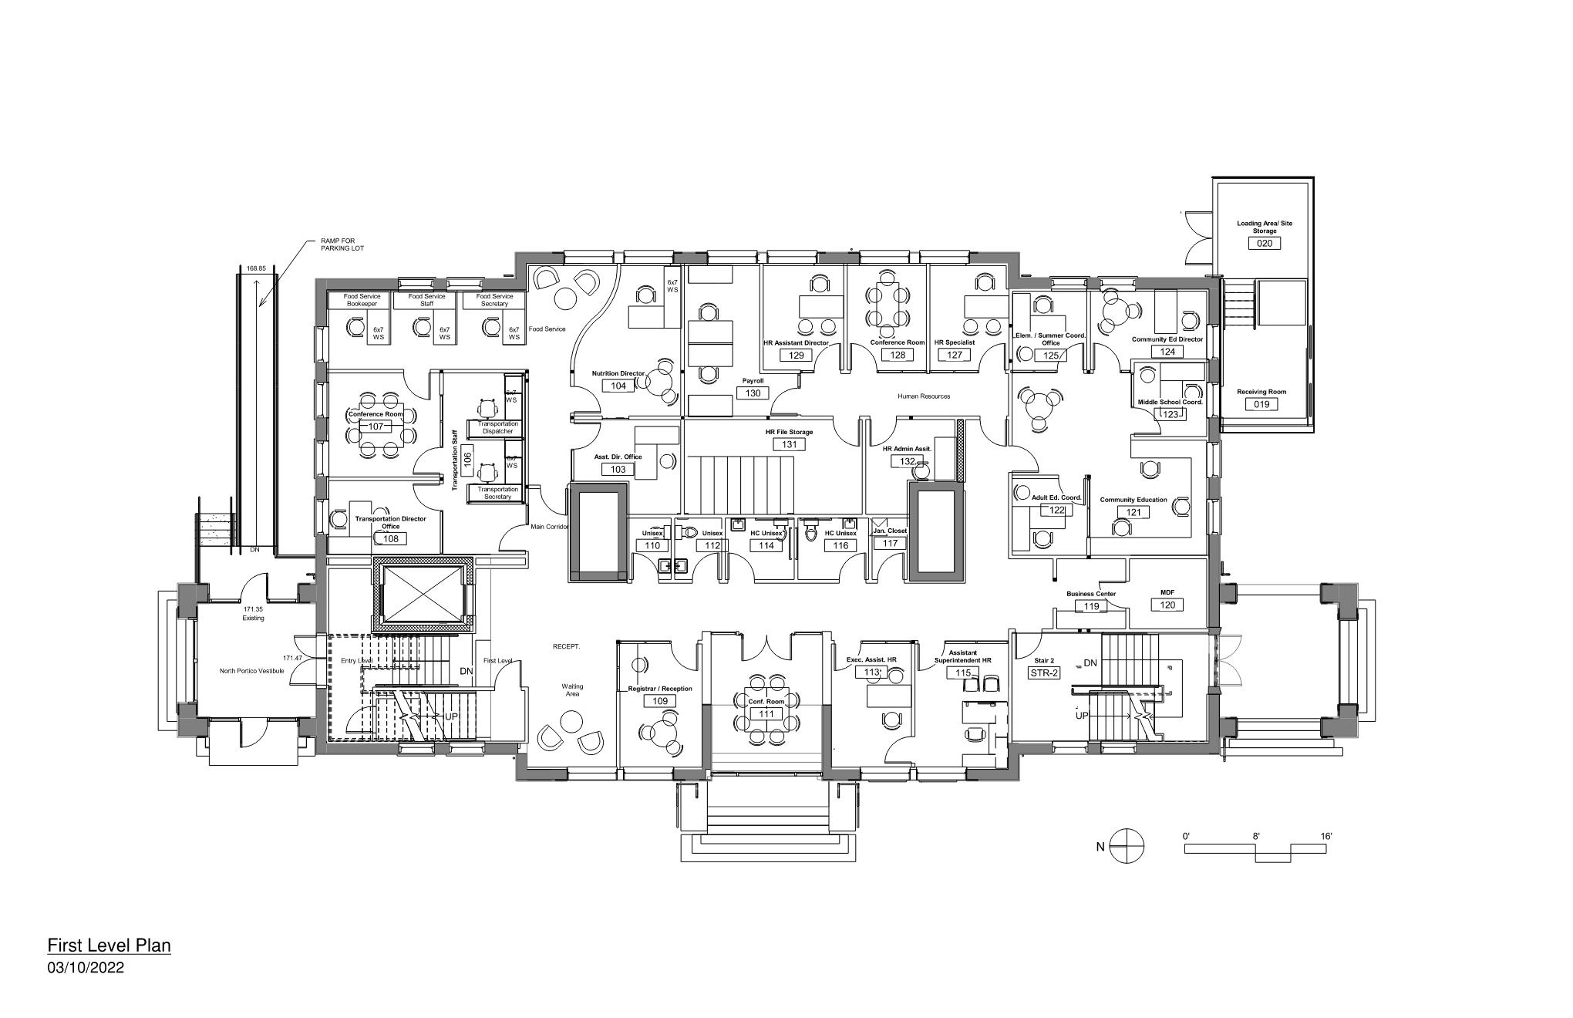
FIRST LEVEL
Transportation &
Nutrition
Human Resources
Handicapped access :
Ramp to the parking
New elevator
Entry Vestibule
Community
Education
Registration &
Family Welcome

Slide 6
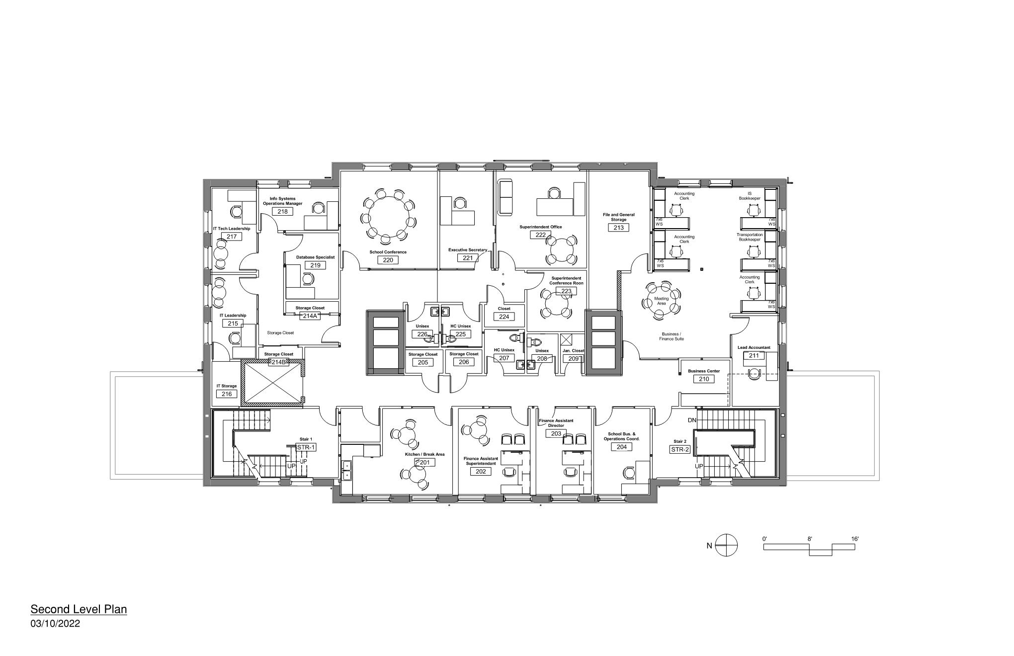
SECOND LEVEL
Superintendent
Information
Technology
Finance

Slide 7
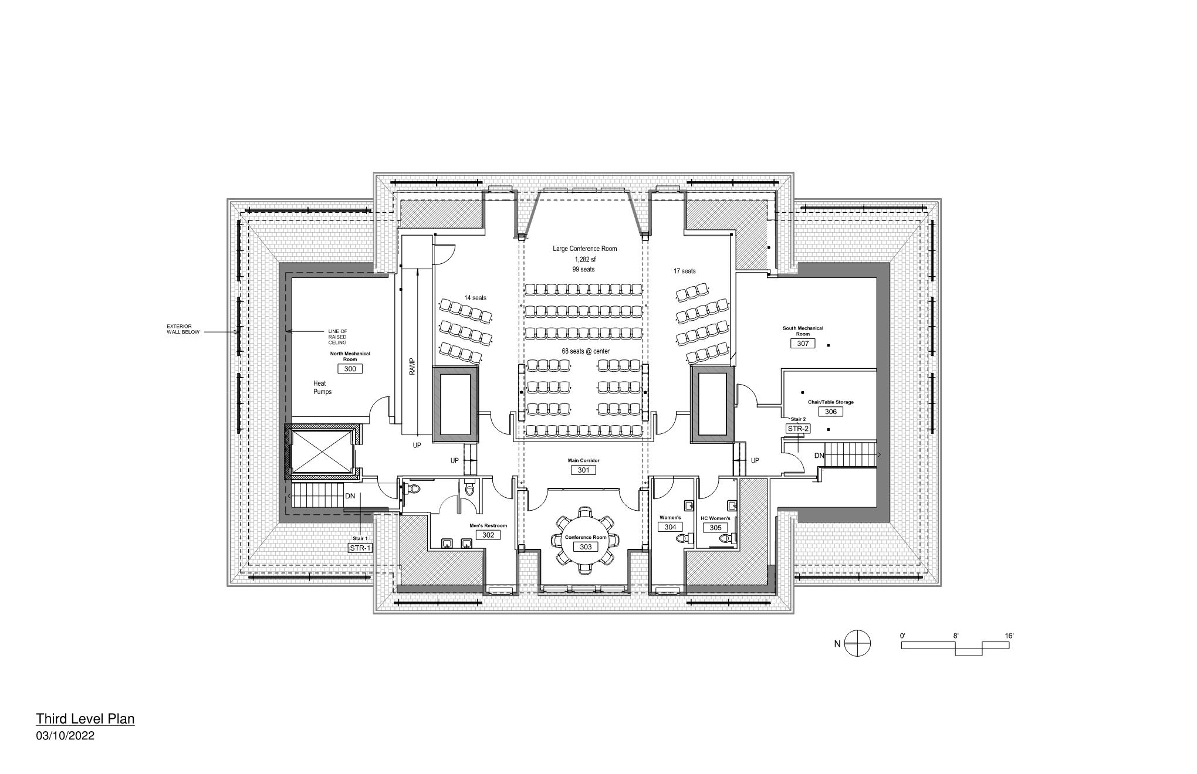
THIRD LEVEL
Large Conference Room
New Dormer for
Mech. Rm.
Elevator
Stair
Small Conference Room

Slide 8
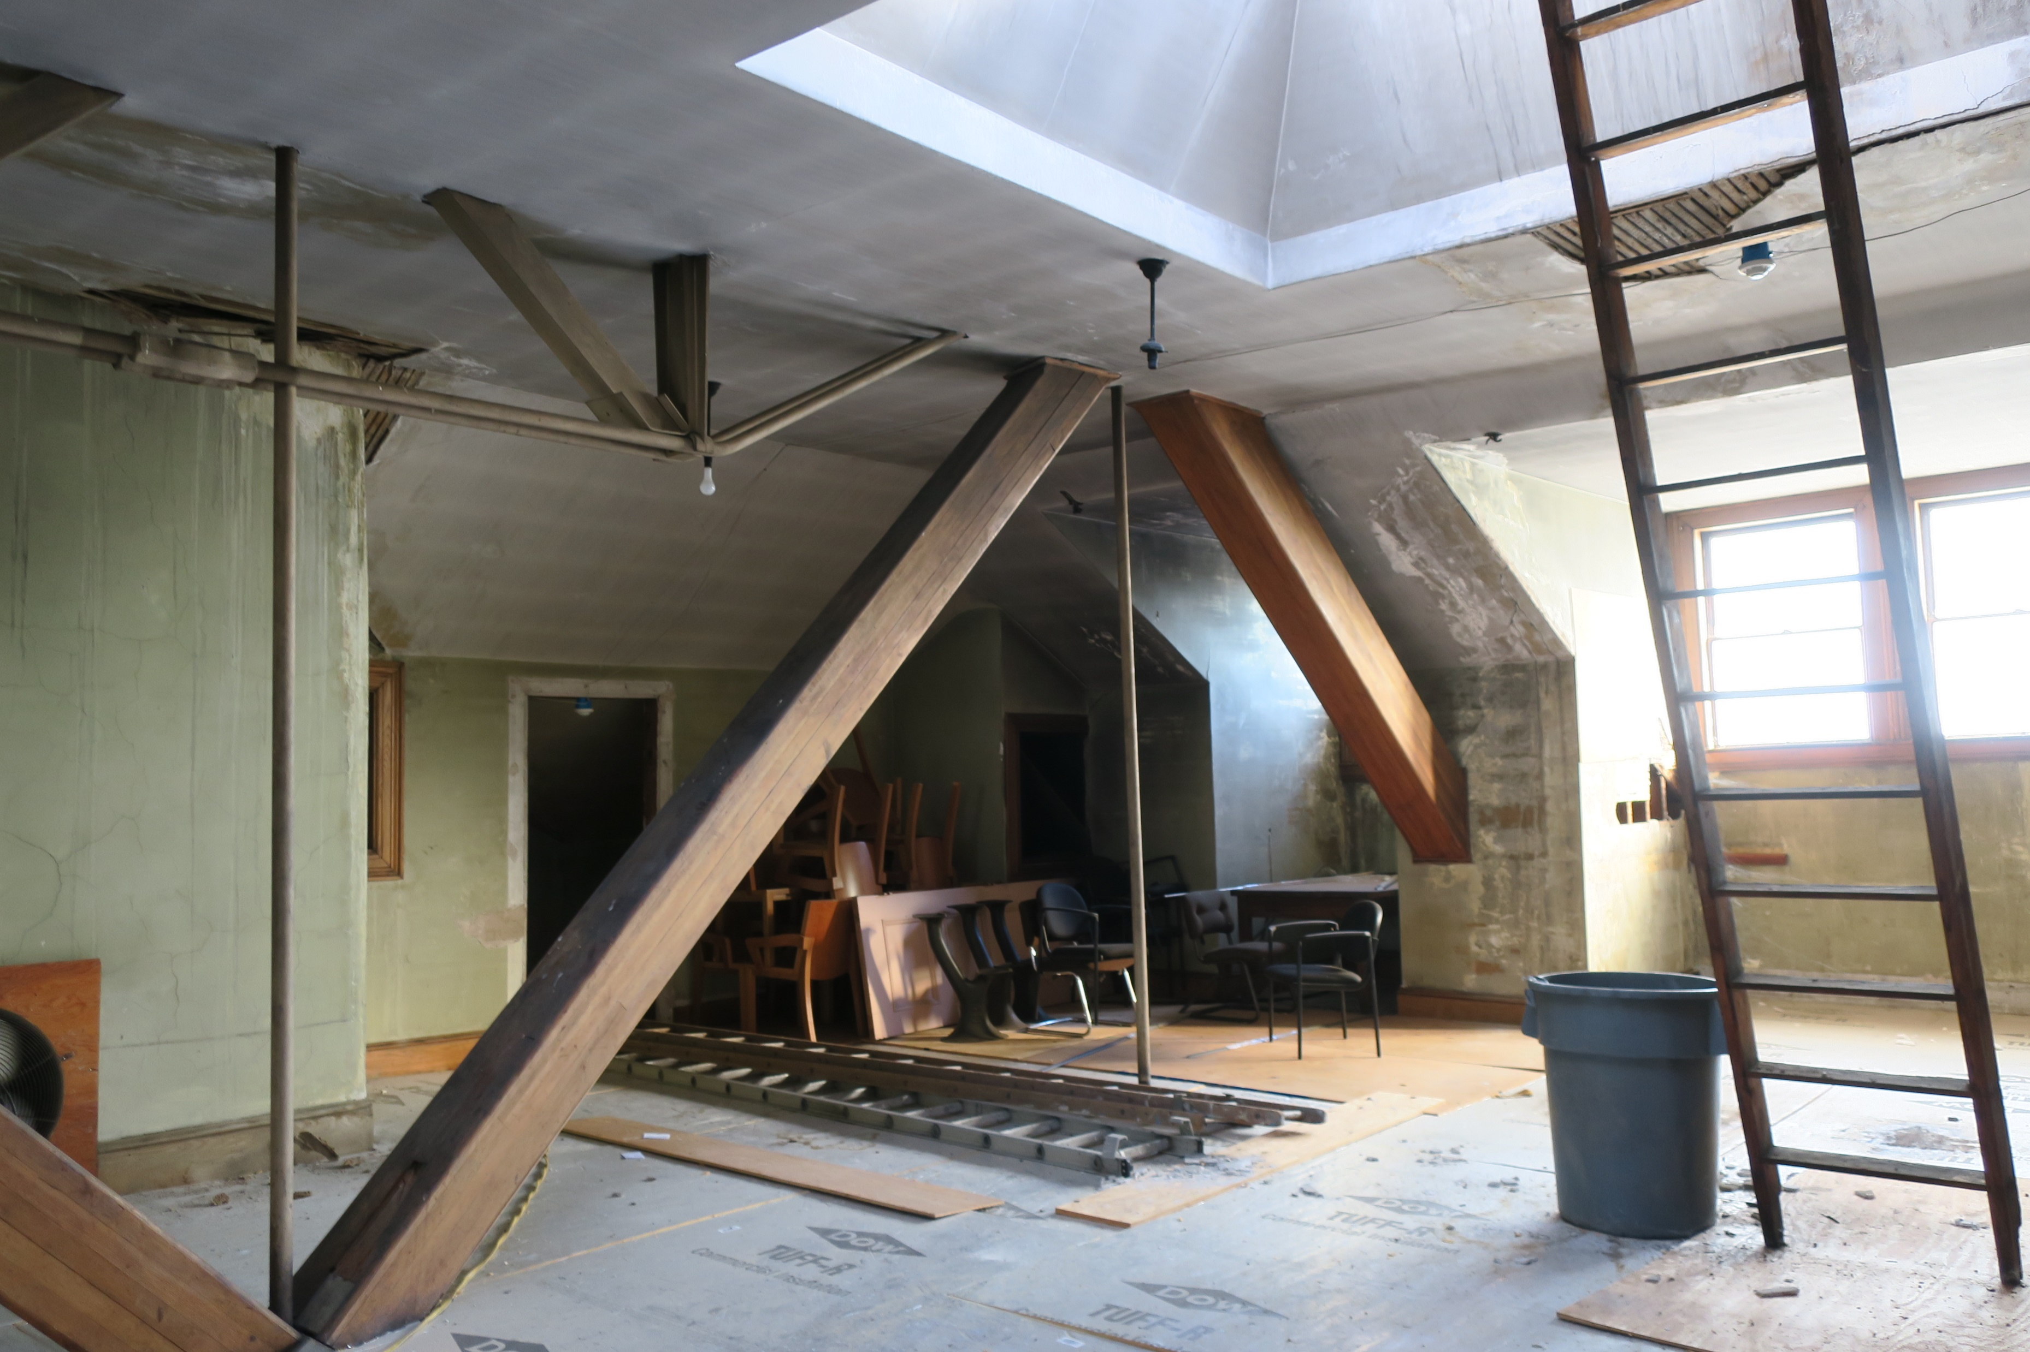
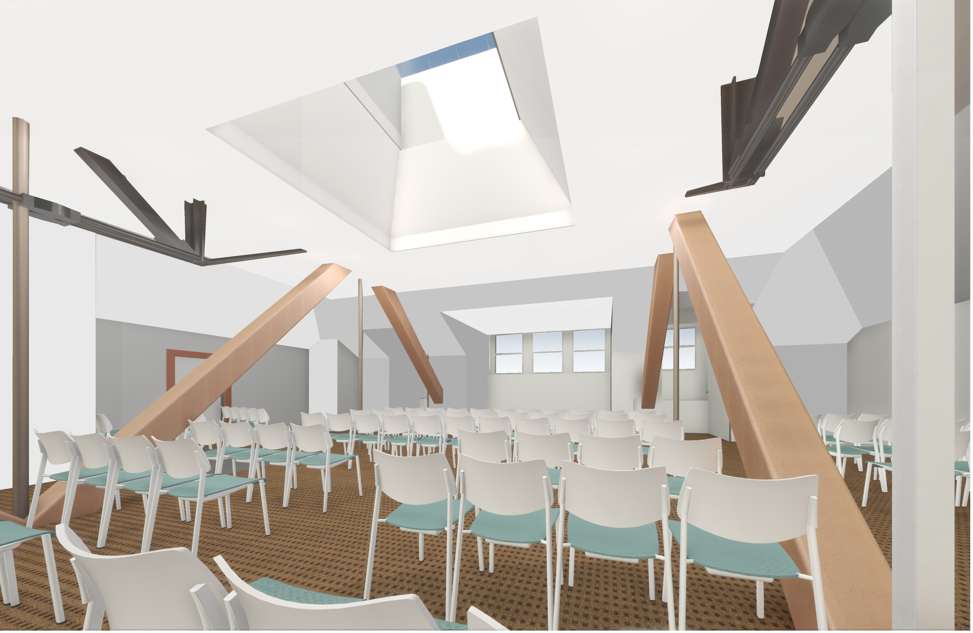
Third Level
Repurpose the top level for the Main Conference Room – keeping the existing trusses

Slide 9
Renovates the historic building shell
North portico vestibule creates an accessible entrance
New dormer houses elevator, stair & mechanical equipment

Slide 10
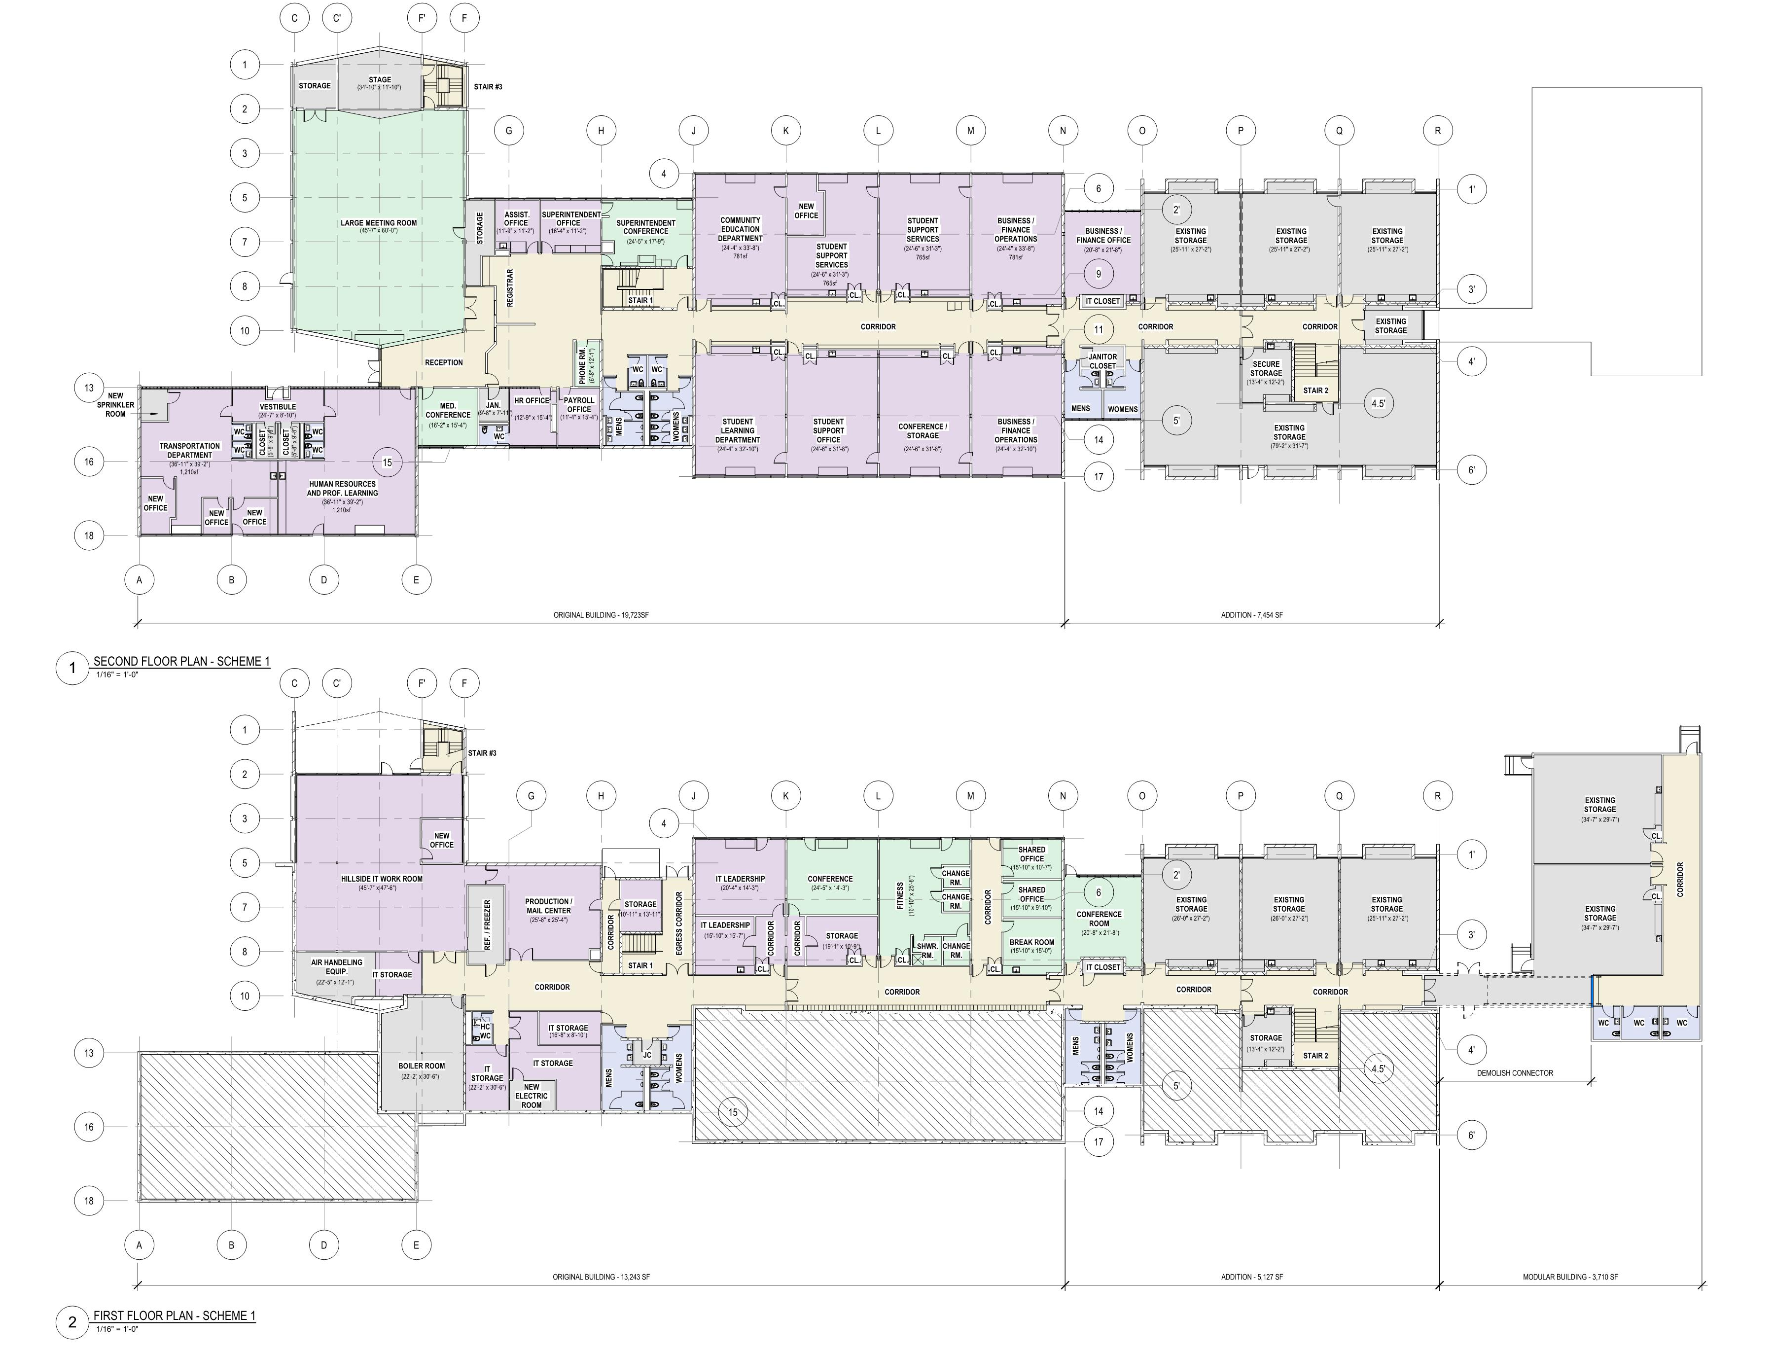
This project includes HILLSIDE SCHOOL
RENOVATIONS
FOR
TEMPORARY
SCHOOL ADMIN.
OFFICES
Demolish link to Modular Classrooms
Drain systems and mothball building

Slide 11
We request your support for Article #21 Appropriate for Emery Grover Renovations
Renovates and restores Needham’s oldest public historic building
Full Core & Shell renovation
New energy efficient windows & roof
New energy efficient HVAC
Emergency exit stairs & automatic sprinklers
Structural upgrades to code
ADA/MAAB accessible, entrance, elevator, bathrooms & etc.
Unanimous support from Needham Historic Commission
CPC funding of $6M approved
$19.4M funding includes CPA funds
Includes funding for Hillside renovations for temp office space
Potential $2M added contingency funding in Oct ‘22 STM pending bid results per PPBC DD estimate

